Slide 1
CS212-Object Oriented Programming
Lecture 09
Graphical User Interface
Study with Chapter 14 and 15 of Course Book

Slide 2
User Interface
The user interface is that part of a program that interacts with the user of the program.
User interfaces take many forms. These forms range in complexity from simple command-line interfaces to the point-and-click graphical user interfaces provided by many modern applications.
At the lowest level, the operating system transmits information from the mouse and keyboard to the program as input, and provides pixels for program output.

Slide 3
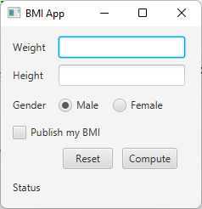
GUI
Lets develop a GUI application to compute Body Mass Index (BMI) – code is available in slides
Assume BMI for
Male: Weight/ Height
Female: 2 + Weight/ Height
Layout of app consists of labels, buttons, textboxes, radio buttons and a checkbox
All these controls are Java Classes
That means we create objects of
these classes (controls), set their
properties and invoke functions

Slide 4
GUI
GUI Application are created using
java.awt
javax.swing
JavaFX.
Pre-Requisite
Netbeans 12.0
JDK 1.8
JavaFx Scene Builder 2.0
Resources
Book Chapter 14 and 15
https://docs.oracle.com/javafx/2/ui_controls/overview.htm
Things you noted during the lecture

Slide 5
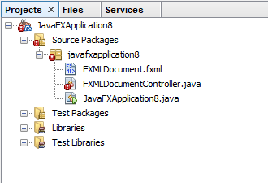
GUI
We shall create GUI app using javaFx
Create a JavaFx project in Netbeans
Open the fxml file in SceneBuilder
Design the GUI using SceneBuilder

Slide 6
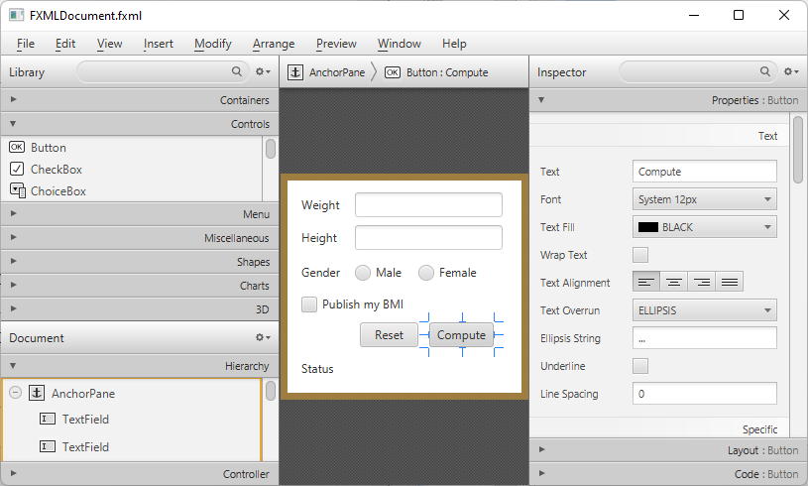
GUI
Design the GUI using SceneBuilder
Set Properties of each GUI element, assign fx:id to elements which needs to be access in code
Adjust TabStop by re-arranging controls in Hierarchy Pane

Slide 7
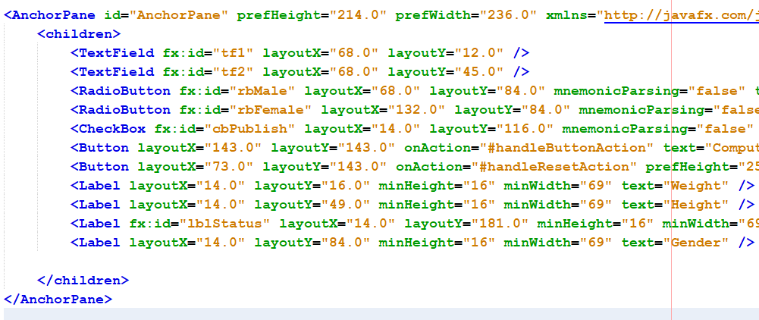
GUI
Or design the GUI by describing layout in fxml file
<AnchorPane id="AnchorPane" prefHeight="214.0" prefWidth="236.0" xmlns="http://javafx.com/javafx/8" xmlns:fx="http://javafx.com/fxml/1" fx:controller="javafxapplication8.FXMLDocumentController">
<children>
<TextField fx:id="tf1" layoutX="68.0" layoutY="12.0" />
<TextField fx:id="tf2" layoutX="68.0" layoutY="45.0" />
<RadioButton fx:id="rbMale" layoutX="68.0" layoutY="84.0" mnemonicParsing="false" text="Male" toggleGroup="$a"/>
<RadioButton fx:id="rbFemale" layoutX="132.0" layoutY="84.0" mnemonicParsing="false" text="Female" toggleGroup="$a" />
<CheckBox fx:id="cbPublish" layoutX="14.0" layoutY="116.0" mnemonicParsing="false" text="Publish my BMI" />
<Button layoutX="143.0" layoutY="143.0" onAction="#handleButtonAction" text="Compute" />
<Button layoutX="73.0" layoutY="143.0" onAction="#handleResetAction" prefHeight="25.0" prefWidth="59.0" text="Reset" />
<Label layoutX="14.0" layoutY="16.0" minHeight="16" minWidth="69" text="Weight" />
<Label layoutX="14.0" layoutY="49.0" minHeight="16" minWidth="69" text="Height" />
<Label fx:id="lblStatus" layoutX="14.0" layoutY="181.0" minHeight="16" minWidth="69" text="Status" />
<Label layoutX="14.0" layoutY="84.0" minHeight="16" minWidth="69" text="Gender" />
</children>
</AnchorPane>

Slide 8
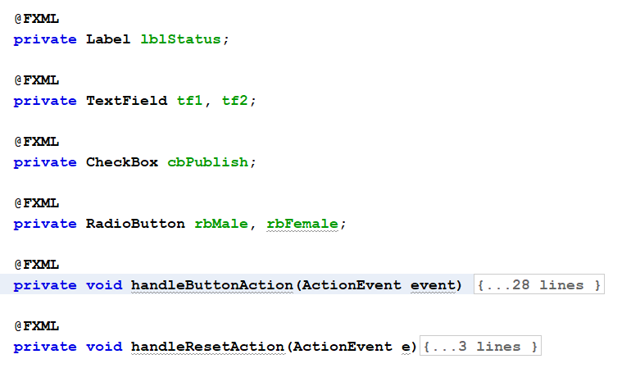
GUI
In Controller java file, declare the controls for which fxid was set in fxml file and write event handlers which are registered in fxml file

Slide 9
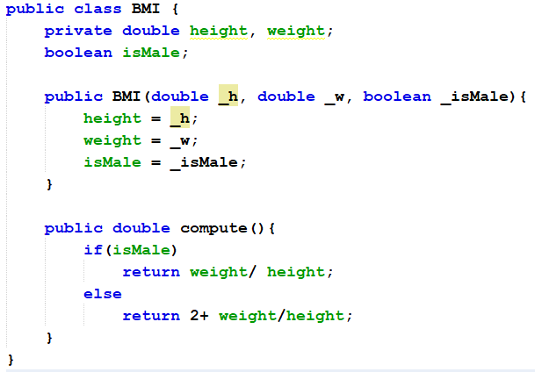
GUI
Add a new class BMI in the project
public class BMI {
private double height, weight;
boolean isMale;
public BMI(double _h, double _w, boolean _isMale){
height = _h;
weight = _w;
isMale = _isMale;
}
public double compute(){
if(isMale)
return weight/ height;
else
return 2+ weight/height;
}
}

Slide 10
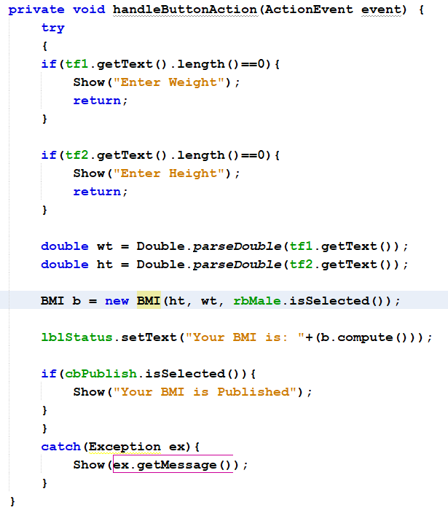
GUI
Implement the compute BMI code in compute button click event handle
If user enter no text,
Alert is shown
Wrong input is
Handled by exceptions
private void handleButtonAction(ActionEvent event) {
try
{
if(tf1.getText().length()==0){
Show("Enter Weight");
return;
}
if(tf2.getText().length()==0){
Show("Enter Height");
return;
}
double wt = Double.parseDouble(tf1.getText());
double ht = Double.parseDouble(tf2.getText());
BMI b = new BMI(ht, wt, rbMale.isSelected());
lblStatus.setText("Your BMI is: "+(b.compute()));
if(cbPublish.isSelected()){
Show("Your BMI is Published");
}
}
catch(Exception ex){
Show(ex.getMessage());
}
}

Slide 11
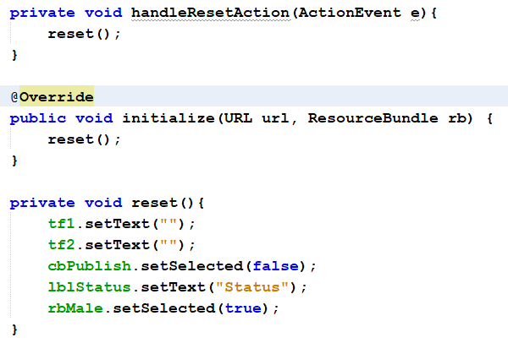
GUI
Implement reset method and call it in Reset Button event handler and initialize method
private void reset(){
tf1.setText("");
tf2.setText("");
cbPublish.setSelected(false);
lblStatus.setText("Status");
rbMale.setSelected(true);
}

Slide 12
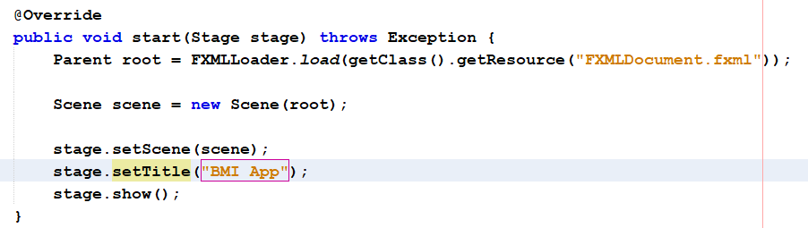
GUI
GUI application in JavaFx is a stage, which has different scenes and each scene is populated by controls
JavaFxApplication Java file sets the stage and adds a scene in it
Controls for the scene are described in fxml file and are loaded from fxml file.
Start method starts the GUI application.
Set title of the application in JavaFxApplication Java file

Slide 13
ADDITIONAL MATERIAL

Slide 14
GUI - AWT
Java AWT(Abstract Window Toolkit) is an API to develop GUI or window-based applications in java
Java AWT components are platform-dependent i.e. components are displayed according to the view of operating system. AWT is heavyweight i.e. its components are using the resources of OS
The java.awt packages provide classes for AWT api such as TextField, Label, TextArea, RadioButton, CheckBox, Choice, List etc.
The java.awt package was the primary repository for classes that are used to create a GUI in java but many of the classes it defines have been superseded by javax.swing
However the Swing classes are generally derived from, and depend on, fundamental classes within java.awt, so these cant be ignored

Slide 15
GUI - AWT
A graphical user interface is built of graphical elements called components
Typical components include such items as buttons, scrollbars, and text fields.
Components allow the user to interact with the program and provide the user with visual feedback about the state of the program.
In the AWT, all user interface components are instances of class Component or one of its subtypes.

Slide 16
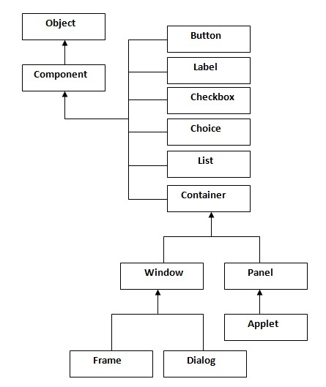
GUI - AWT

Slide 17
GUI - AWT
Components do not stand alone, but rather are found within containers.
Containers contain and control the layout of components. Containers are themselves components, and can thus be placed inside other containers.
In the AWT, all containers are instances of class Container or one of its subtypes.
Spatially, components must fit completely within the container that contains them.

Slide 18
GUI - AWT
Container The Container is a component in AWT that can contain another components like buttons, textfields, labels etc. The classes that extends Container class are known as container such as Frame, Dialog and Panel.
Window The window is the container that has no borders and menu bars. You must use frame, dialog or another window for creating a window
Panel The Panel is the container that doesn't contain title bar and menu bars. It can have other components like button, textfield etc.
Frame The Frame is the container that contains title bar and can have menu bars. It can have other components like button, textfield etc.

Slide 19
GUI - AWT
Useful Methods of Component class
Method | Description
public void add(Component c) | inserts a component on this component.
public void setSize(int width, int height) | sets the size (width and height) of the component.
public void setLayout(LayoutManager m) | defines the layout manager for the component.
public void setVisible(boolean status) | changes the visibility of the component, by default false.

Slide 20
GUI - AWT
To create simple awt example, you need a frame. There are two ways to create a frame in AWT.
By extending Frame class (inheritance)
By creating the object of Frame class (association)

Slide 21
GUI - AWT
import java.awt.*;
class First extends Frame{
First(){
Button b=new Button("click me");
b.setBounds(30,100,80,30); // setting button position
add(b); //adding button into frame
setSize(300,300); //frame size 300 width and 300 height
setLayout(null);//no layout manager
setVisible(true);//now frame will be visible, by default not visible
}
public static void main(String args[]){
First f=new First();
}}

Slide 22
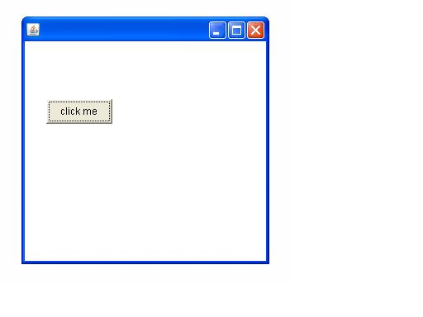
GUI - AWT

Slide 23
GUI – Java Swing
Java Swing is a part of Java Foundation Classes (JFC) that is used to create window-based applications. It is built on the top of AWT (Abstract Windowing Toolkit) API and entirely written in java.
Unlike AWT, Java Swing provides platform-independent and lightweight components.
The javax.swing package provides classes for java swing API such as JButton, JTextField, JTextArea, JRadioButton, JCheckbox, JMenu, JColorChooser etc.
What is JFC The Java Foundation Classes (JFC) are a set of GUI components which simplify the development of desktop applications.

Slide 24
GUI – Java Swing

Slide 25
GUI – Java Swing

Slide 26
GUI – Java Swing
Components
A component represents a graphical entity of one kind or another that can be displayed on screen
All container and visual components inherit from java.awt.Component
Key Classes: Window, JFrame, JDialog, JApplet etc

Slide 27
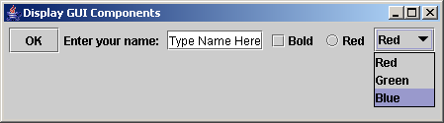
GUI – Java Swing
// Create a button with text OK
Jbutton jbtOK = new JButton("OK");
// Create a label with text "Enter your name: "
Jlabel jlblName = new JLabel("Enter your name: ");
// Create a text field with text "Type Name Here"
JTextField jtfName = new JTextField("Type Name Here");
// Create a check box with text bold
JCheckBox jchkBold = new JCheckBox("Bold");
// Create a radio button with text red
JRadioButton jrbRed = new JRadioButton("Red");
// Create a combo box with choices red, green, and blue
JComboBox jcboColor = new JComboBox(new String[]{"Red",
"Green", "Blue"});
Label
Text field
Check Box
Radio Button
Combo Box

Slide 28
GUI – Java Swing
Frame
Frame is a window that is not contained inside another window. Frame is the basis to contain other user interface components in Java GUI applications.
The JFrame class can be used to create windows.
For Swing GUI programs, use JFrame class to create windows.

Slide 29
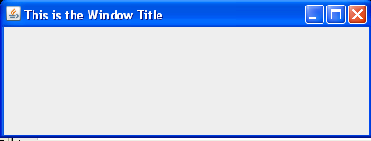
GUI – Java Swing
import javax.swing.JFrame;
public class TryWindow {
// The window object
static JFrame aWindow = new JFrame("This is the Window Title");
public static void main(String[] args) {
int windowWidth = 400; // Window width in pixels
int windowHeight = 150; // Window height in pixels
aWindow.setBounds(50, 100, // Set position
windowWidth, windowHeight); // and size
aWindow.setDefaultCloseOperation(JFrame.EXIT_ON_CLOSE);
aWindow.setVisible(true); // Display the window
}}

Slide 30
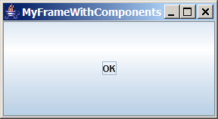
GUI – Java Swing
// Add a button into the frame
frame.getContentPane().add(
new JButton("OK"));
Title bar
Content pane

